Slide 1


Data Analytics

Slide 2


Today's agenda
Project Recap
Problem
We will review key points from the brief, outlining the scope and objectives of the project and provide a summary of the entire project..
The Analytics Team
We'll introduce the members of our team and their respective roles in the project. I'll start by outlining the issue and then discuss the team that is in charge of handling this assignment on our end.
Process
Insights & Summary
We'll identify the primary challenge and particular issue Social Buzz is facing and provide some context for why this is such a significant issue.
We'll outline the methodology and steps undertaken to conduct our analysis and so you can fully understand how we approach tasks of this nature.
Finally, we'll present the key findings and provide a concise summary of our analysis and recommendations.

Slide 3

“Social Buzz”, a rapidly expanding unicorn in the technology space, has engaged Accenture for a 3-month POC project.
During this engagement, Accenture will undertake the following activities:
Examination of Social Buzz's utilization of big data
Development of strategies for a prosperous IPO
Identification of the top 5 content categories on Social Buzz platform
Project Recap

Slide 4

Problem
100k+ daily posts → 36M annual posts
Difficult to handle such big data
Identify top 5 categories with the largest aggregate popularity

Slide 5


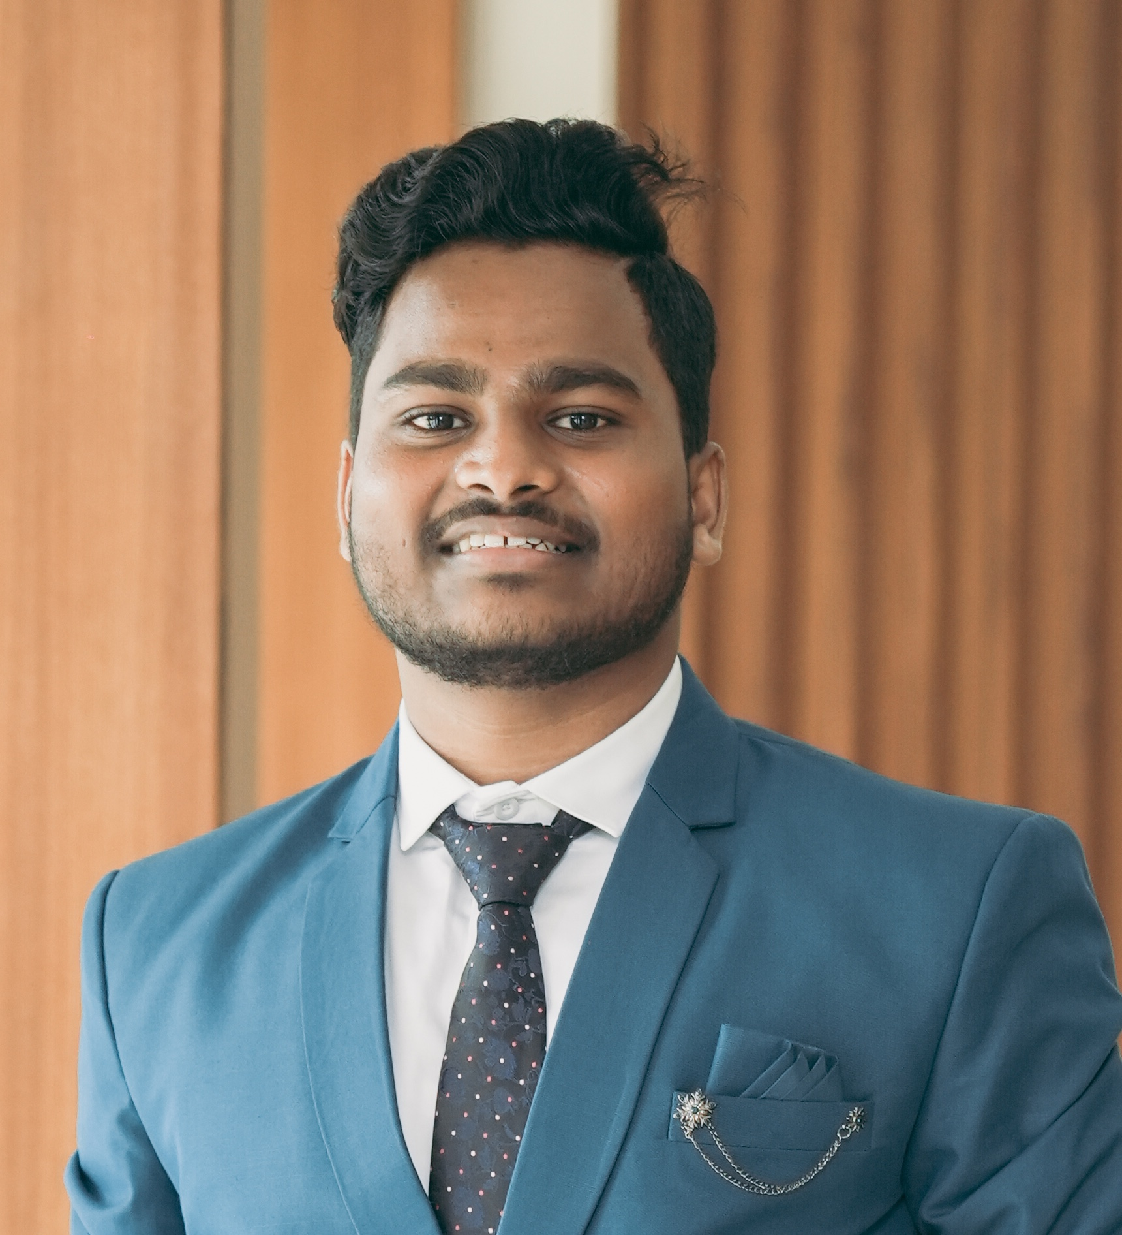
Andrew Fleming
Chief Technical Architect
The Analytics team
Marcus Rompton
Senior Principle
John Kiran
Data Analyst

Slide 6
Requirements Gathering
Process
1
Data Collection + Understanding
2
Data Cleanup + Modelling
3
4
Data Analysis
5
Insights Generation

Slide 7

Insights
Unique Categories
Category With Highest Score
Month With Most Posts
Animals
16
74.9K
February

Slide 10

The top 5 categories were found are:
Animals
Science
Healthy Eating
Technology
Food
Food seems to be prominent after animals and science and it can be improved by collaboration with healthy eating brands along with leading digital companies to improve user engagement in both food & technological content
Summary

Slide 11

Thank you!
ANY QUESTIONS?

